Slide 1
Making your students
College and Career Ready

Slide 2
About Us
Competitions
Certifications
Leadership & Service
Conference
Community
Basics
Career and Technical Student Organization (CTSO) for business and computer science fields
History
Founded in 1966 as the Office Education Association (OED); renamed Business Professionals of America (BPA) in 1988
Membership
Divisions for middle school, high school, and college/university students
Our Motto
Giving Purpose to Potential

Slide 3
About Us
Competitions
Certifications
Leadership & Service
Conference
Community
Top 5 Reasons to Affiliate with BPA
◆ Robust Competitions  Industry Certifications  Leadership & Service Programs  Dynamic National Conference  BPA Community

Slide 4
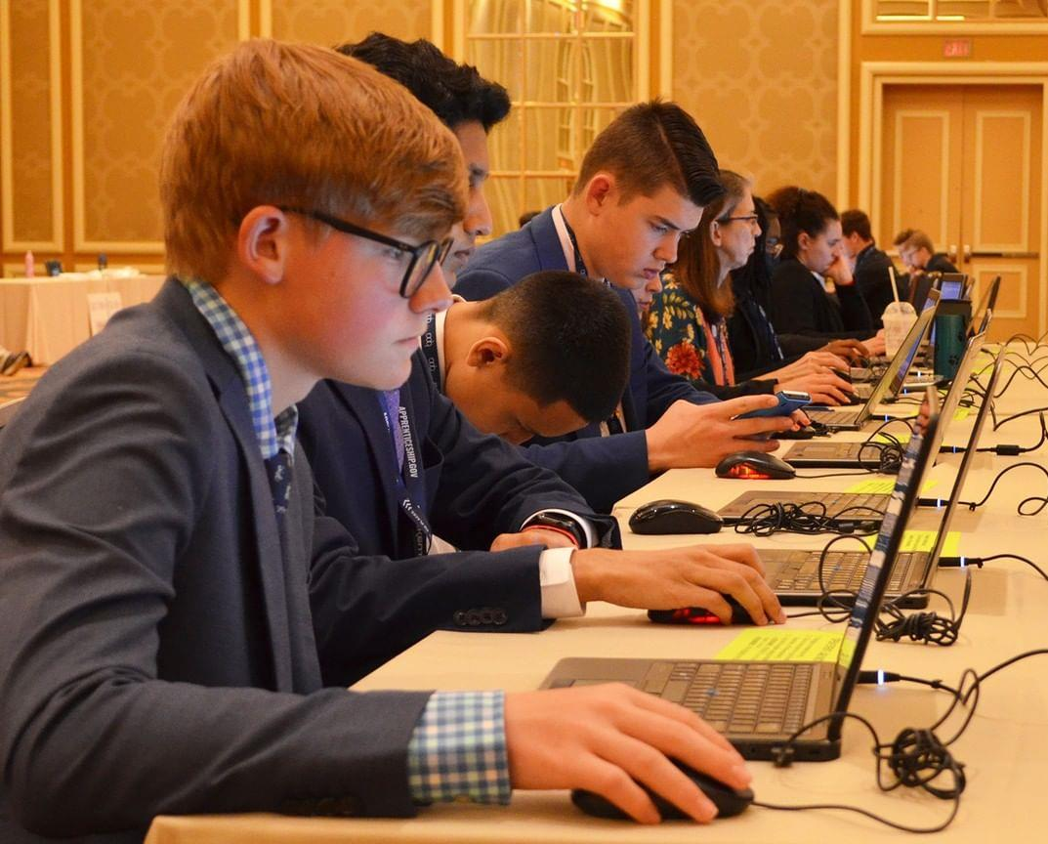
Workplace Skills Assessment Program
Competitions
Events organized into six content areas plus national virtual events
Competition formats are objective tests, projects, activities, and presentations
Detailed guidelines, competencies, and rubrics are provided
Some events (national level) include industry certification exams
About Us
Competitions
Certifications
Leadership & Service
Conference
Community
Workplace Skills Assessment Program

Slide 5
Competition Assessment Areas
Business Administration
Digital Communications & Design
Finance
Health Administration
Management Information Systems
Management, Marketing & Communications
Virtual Competitions (National Level Only)
About Us
Competitions
Certifications
Leadership & Service
Conference
Community

Slide 6
Business Administration
Secondary Division
Administrative Support Concepts - Open Event
Administrative Support Research Project
Administrative Support Team
Business Law and Ethics
Database Applications
Integrated Office Applications
Legal Office Procedures
Office Systems and Procedures
Office Systems and Procedures, Advanced
Spreadsheet Applications, Fundamental
Spreadsheet Applications, Advanced
Word Processing, Fundamental
Word Processing, Intermediate
Word Processing, Advanced
About Us
Competitions
Certifications
Leadership & Service
Conference
Community

Slide 7
Digital Communications & Design
Secondary Division
Broadcast News Production Team
Computer Animation Team
Computer Modeling
Desktop Publishing, Fundamental
Desktop Publishing, Advanced
Digital Communication and Design Concepts - Open Event
Digital Media Production
Graphic Design Promotion
Podcast Production Team
User Experience Design Team
Video Production Team
Visual Design Team - Pilot
Web Design, Fundamentals of
Website Design Team
About Us
Competitions
Certifications
Leadership & Service
Conference
Community

Slide 8
Finance
Secondary Division
Accounting, Fundamental
Accounting, Advanced
Accounting, Payroll
Banking and Finance
Economic Research Individual
Economic Research Team
Financial Analyst Team
Financial Math and Analysis Concepts - Open Event
Personal Financial Management
About Us
Competitions
Certifications
Leadership & Service
Conference
Community

Slide 9
Health Administration
Secondary Division
Health Administration Procedures
Health Insurance and Medical Billing
Health Research Presentation
Medical Coding
Health Administration Concepts - Open Event
About Us
Competitions
Certifications
Leadership & Service
Conference
Community

Slide 10
Management Information Systems
Secondary Division
C# Programming
C++ Programming
Computer Network Technology
Computer Programming Concepts - Open
Computer Security
Device Configuration & Troubleshooting
Information Technology Concepts - Open
Java Programming
Linux Operating System Fundamentals
Network Administration Using Cisco®
Network Design Team
Python Programming
Server Administration Using Microsoft®
SQL Database Fundamentals
About Us
Competitions
Certifications
Leadership & Service
Conference
Community

Slide 11
Management, Marketing & Communications
Secondary Division
Digital Marketing Concepts - Open Event
Entrepreneurship
Ethics and Professionalism
Global Marketing Team
Human Resource Management
Interview Skills
Interview Skills, Advanced
Management, Marketing, and Human Resources Concepts - Open Event
Meeting and Event Planning Concepts - Open Event
Parliamentary Procedure Concepts - Open Event
Parliamentary Procedure Team
Presentation Individual
Presentation Team
Small Business Management Team
Speech, Extemporaneous
Speech, Prepared
About Us
Competitions
Certifications
Leadership & Service
Conference
Community

Slide 12
Virtual Competitions (National Level Only)
Secondary Division – Register by December 1
2D Animation Team - Pilot
Cybersecurity/Digital Forensics
Esports Team - Pilot
Ethical Leadership and Decision-Making Team - Pilot
Financial Portfolio Management Team
Mobile Applications
Promotional Photography
Social Media Marketing Campaign Team - Pilot
Software Engineering Team
Start-up Enterprise Team
Virtual Branding Team
Virtual Multimedia and Promotion Individual
Virtual Multimedia and Promotion Team
Web Application Team
About Us
Competitions
Certifications
Leadership & Service
Conference
Community

Slide 13
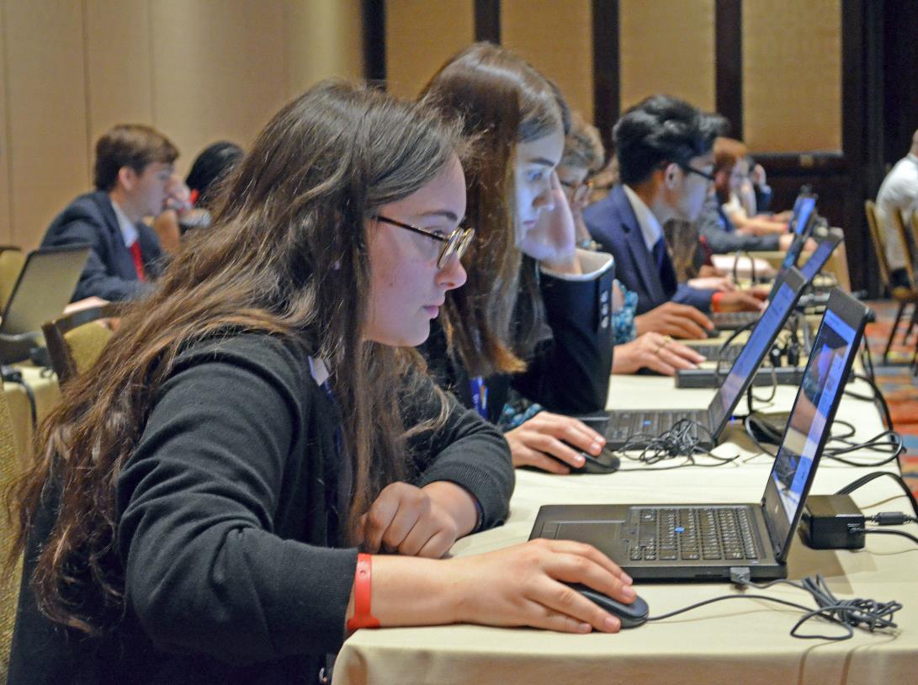
Industry Certifications
2022-2023
BPA Events
Obtained valuable certifications at the National Leadership Conference
19 competitions at nationals include required certification exams
Discounted passes to open certification labs provide access to dozens of other exams, including 31 aligned with other competitions
About Us
Competitions
Certifications
Leadership & Service
Conference
Community

Slide 14
Torch Awards Program
2022-2023
BPA Events
About Us
Competitions
Certifications
Leadership & Service
Conference
Community
Torch Awards promote leadership, professionalism, and community engagement—key characteristics of well-rounded citizens.
By completing diverse activities in seven Torch categories, members earn recognition at the chapter, state, and national levels.
National Torch Ceremony

Slide 15
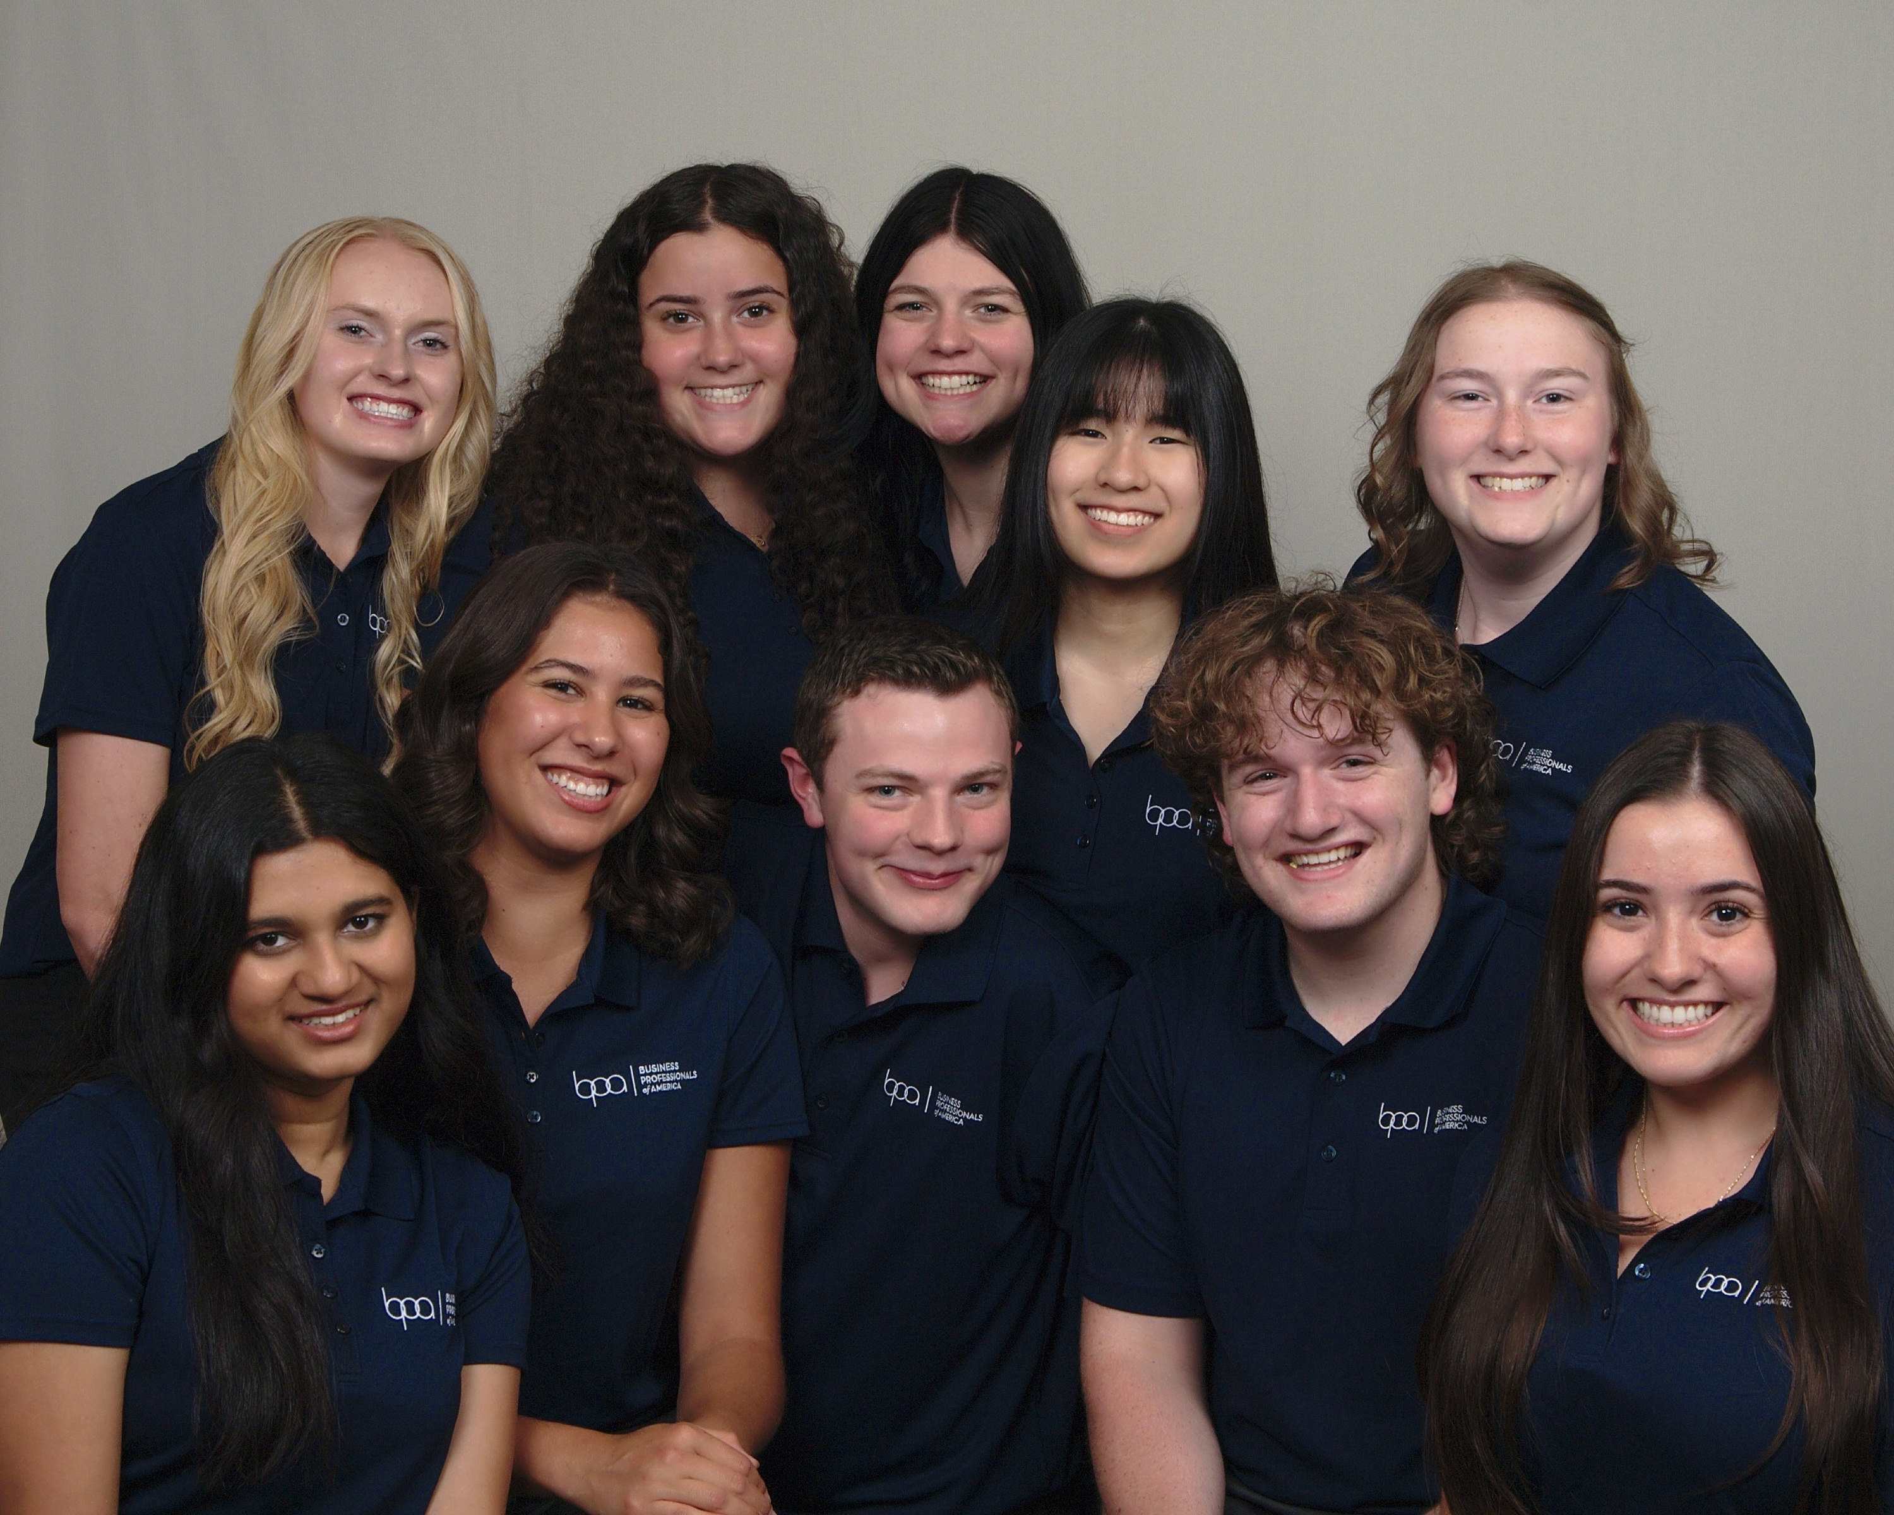
Developing Student Leaders
2022-2023
BPA Events
Leadership opportunities
Chapter, regional, state, and executive officers play important roles in planning and implementing BPA programs.
Members have access leadership workshops and training opportunities.
About Us
Competitions
Certifications
Leadership & Service
Conference
Community
2023–2024 Executive Council  National student leadership team

Slide 16
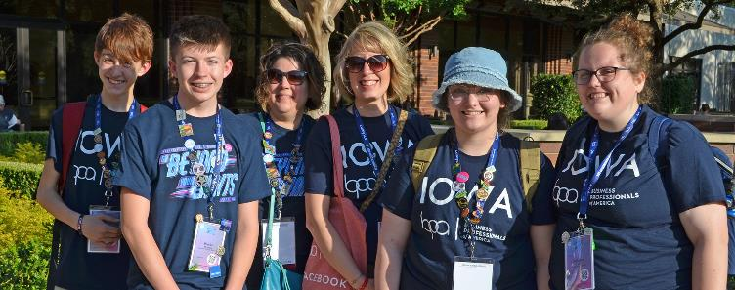
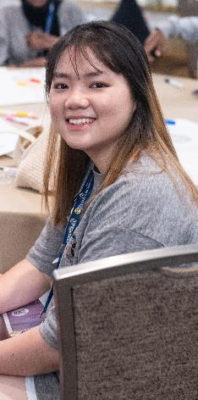
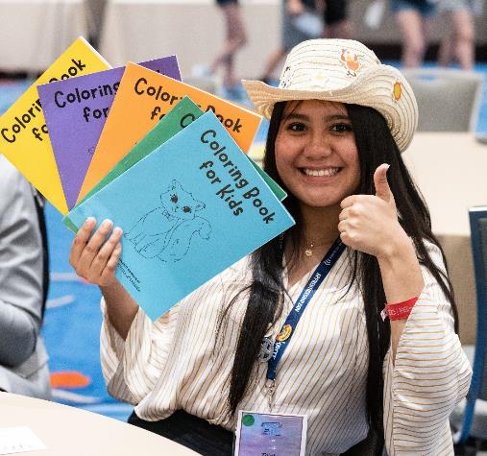
BPA Cares Program
2022-2023
BPA Events
Service to the Community
BPA Cares encourages chapters and members to participate in service projects that help others, promote community betterment, or improve their schools.
Chapters and members can earn BPA Cares Awards for their outstanding commitment to community service.
About Us
Competitions
Certifications
Leadership & Service
Conference
Community
Blood Drives  Food Pantries  Coat Drives  Special Olympics  Military and Veterans  Safety Awareness  Environmental Action  And More!

Slide 17
National Leadership Conference
2022-2023
BPA Events
Future Sites
2025
Orlando
May 7–11
2026
Nashville
May 6–10
2027
Denver
May 5–9
About Us
Competitions
Certifications
Leadership & Service
Conference
Community
May 10-14, 2024  Chicago, Illinois

Slide 18
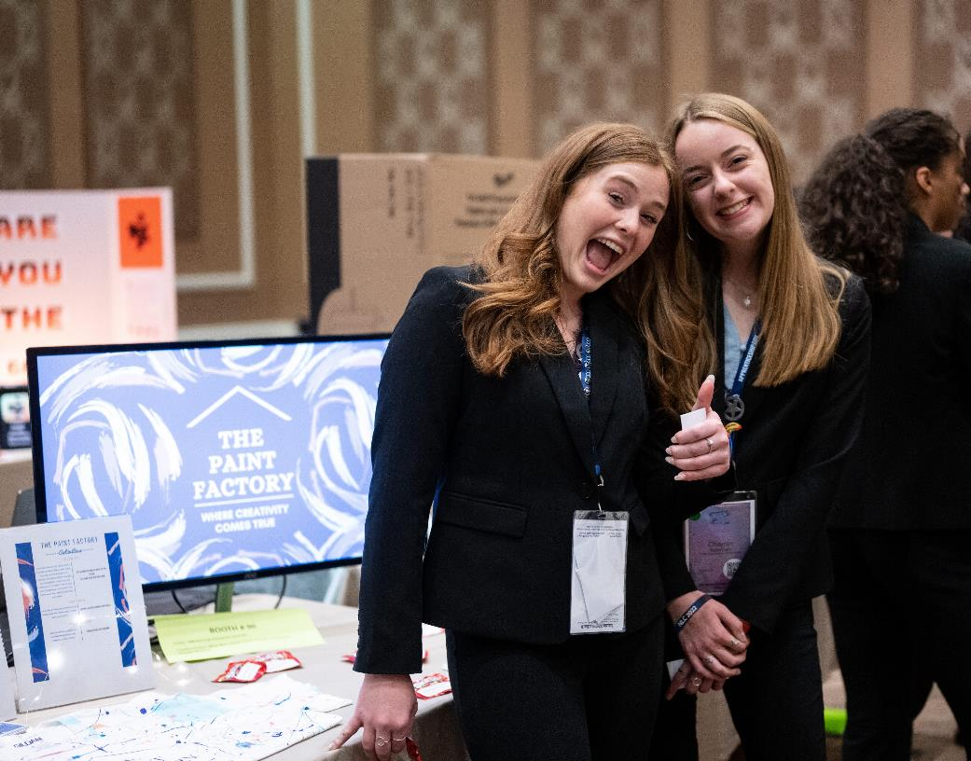
More Benefits of BPA
National awards for chapter, advisor, and member achievements
National partner competitions
Student scholarships
Webinars for advisors and student members
Chapter handbook, member recruitment materials, custom chapter logo package, and other resources for advisors
About Us
Competitions
Certifications
Leadership & Service
Conference
Community
BPA National Showcase

Slide 19
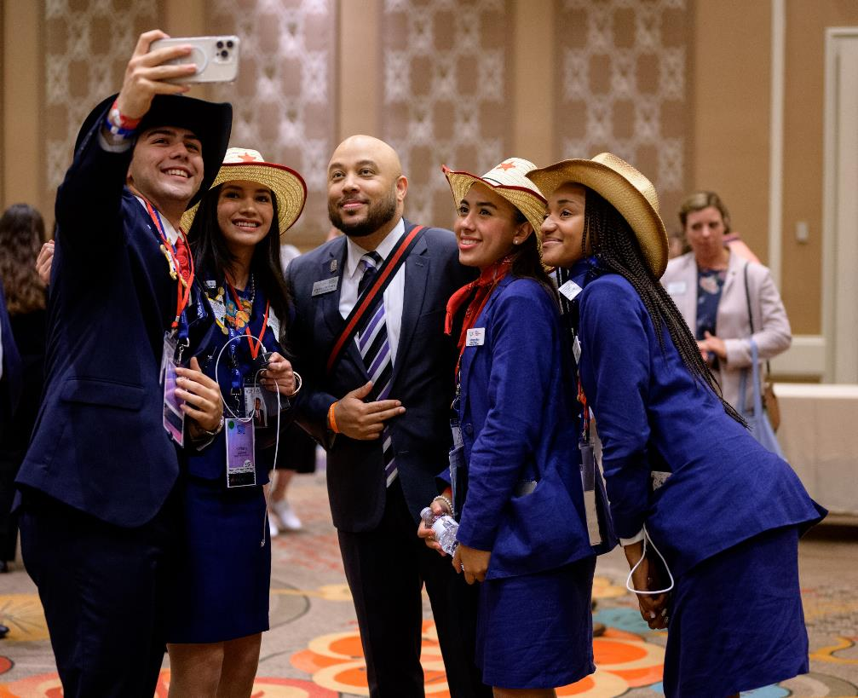
BPA Community
2022-2023
BPA Events
BPA Culture
BPA members, advisors, staff, and other stakeholders love the organization and are part of a supportive community united in promoting and celebrating Career and Technical Education, learning, and student success.
About Us
Competitions
Certifications
Leadership & Service
Conference
Community
About Us
Competitions
Certifications
Leadership & Service
Conference
Community

Slide 20
For more information
BPA National Center
700 Morse Road, Suite 201
Columbus, OH 43214
Patrick Schultz
Director of Membership & Technology
pschultz@bpa.org
www.BPA.org
We would love to have you join us!

